Slide 1

2nd Interview
Task Presentation
Street-Level Crime Data
Anurag Vuppala

Slide 2
Task
Request from an analytical team to load street level crimes data into a DB and supply them with monthly crime counts by type for every street in the UK so they could use this in risk modelling.

Slide 3
Datasets Characteristics
GOODs
BADs
Fixed features(columns)
Fixed data type
Lots of missing values
Inconsistent Crime DI

Slide 4
Sub Tasks
Data Extraction
Data cleaning
Data transformation
Data loading to database(Snowflake)
Monthly crime count for each street in UK

Slide 5
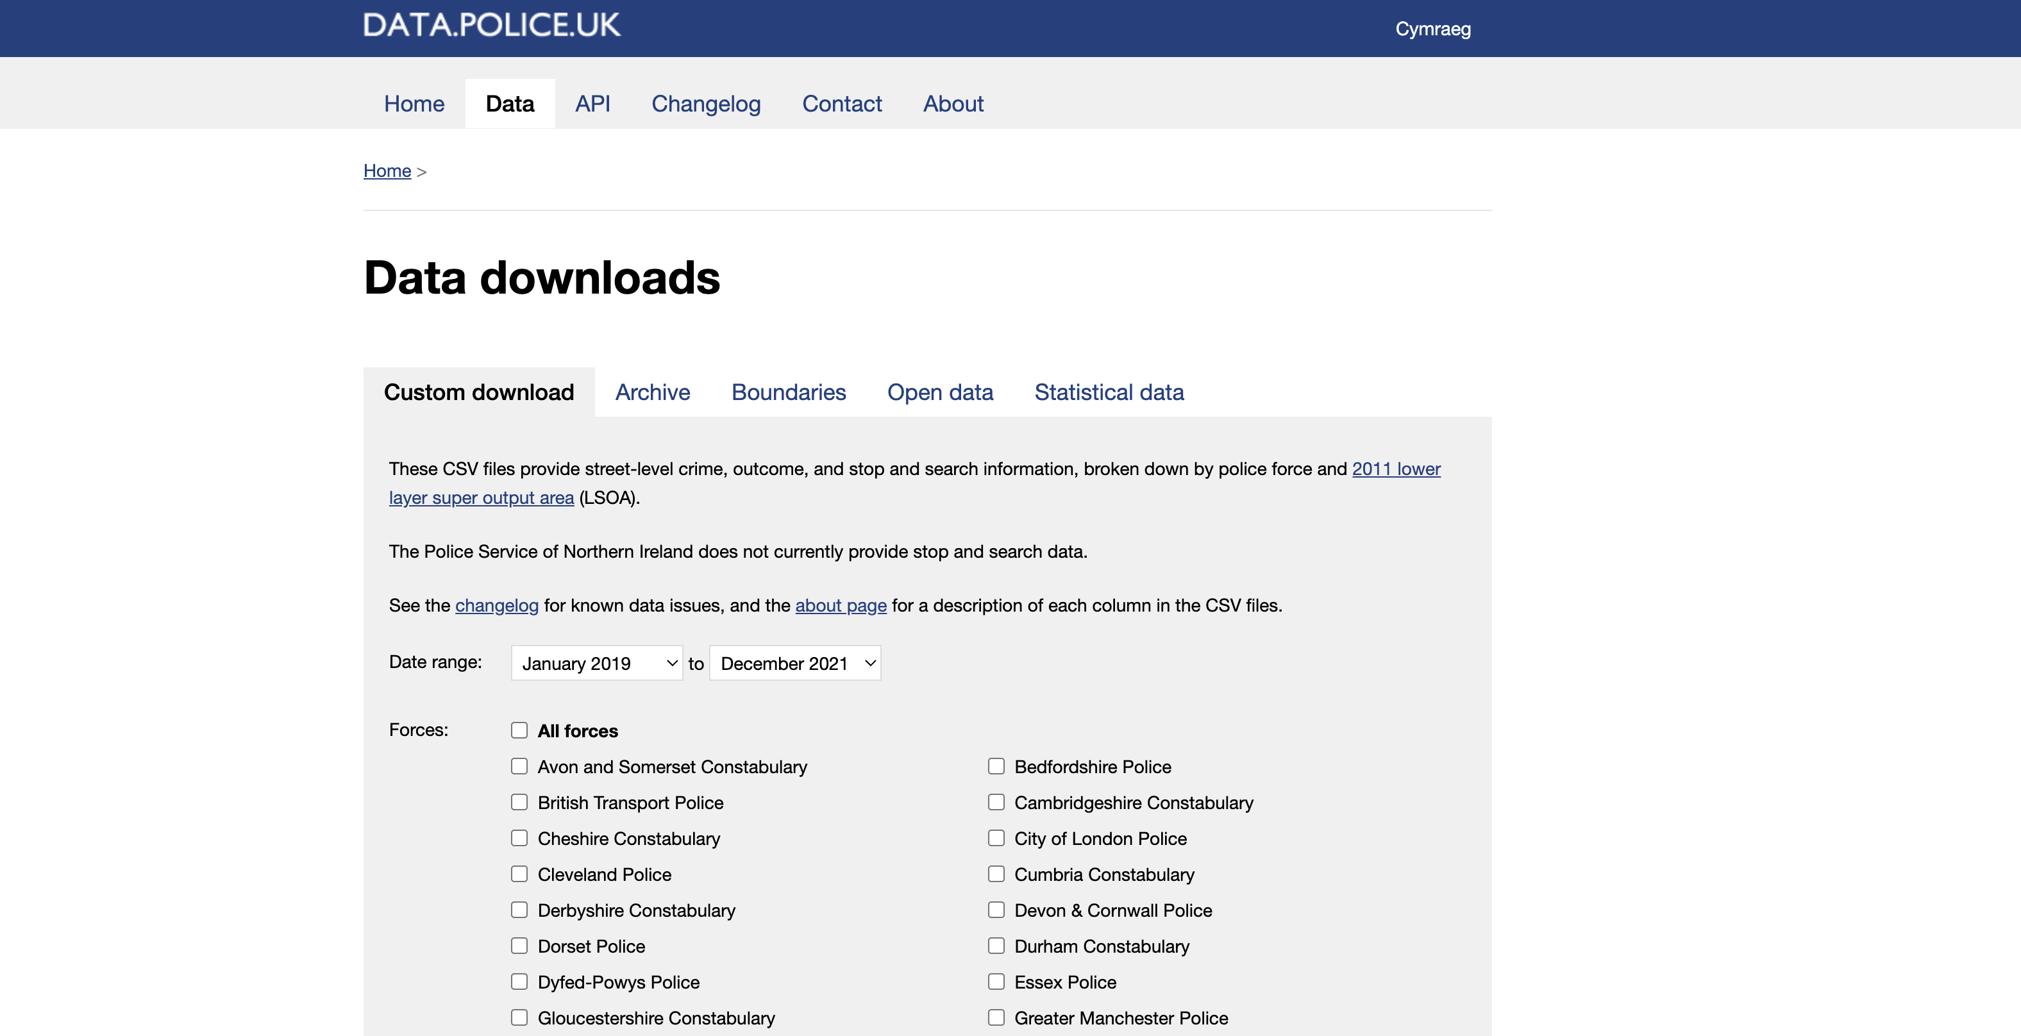
Data Extraction
Street level crime data has been downloaded using a web browser and pasted into a raw data folder

Slide 6
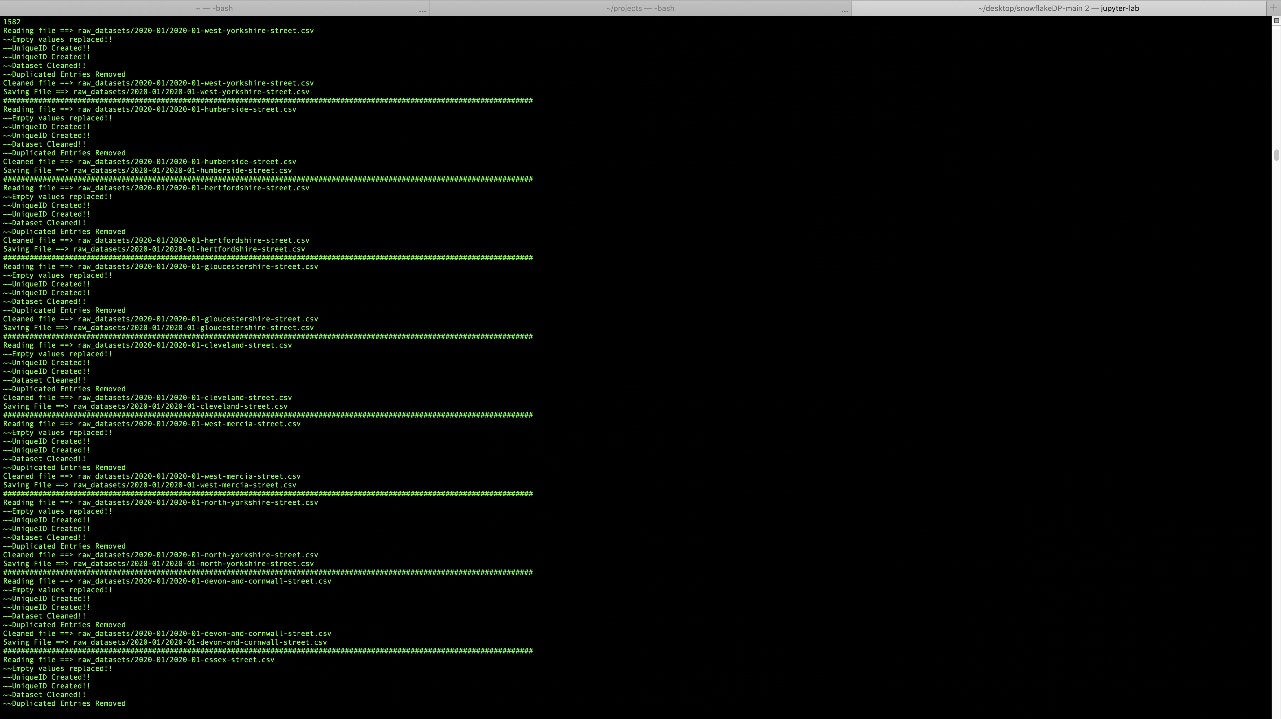
Data Cleaning
Replaced null values with NA in string column and 0 in integer.
Checked data type consistency
Removed unsupported characters by database for the dataset

Slide 7
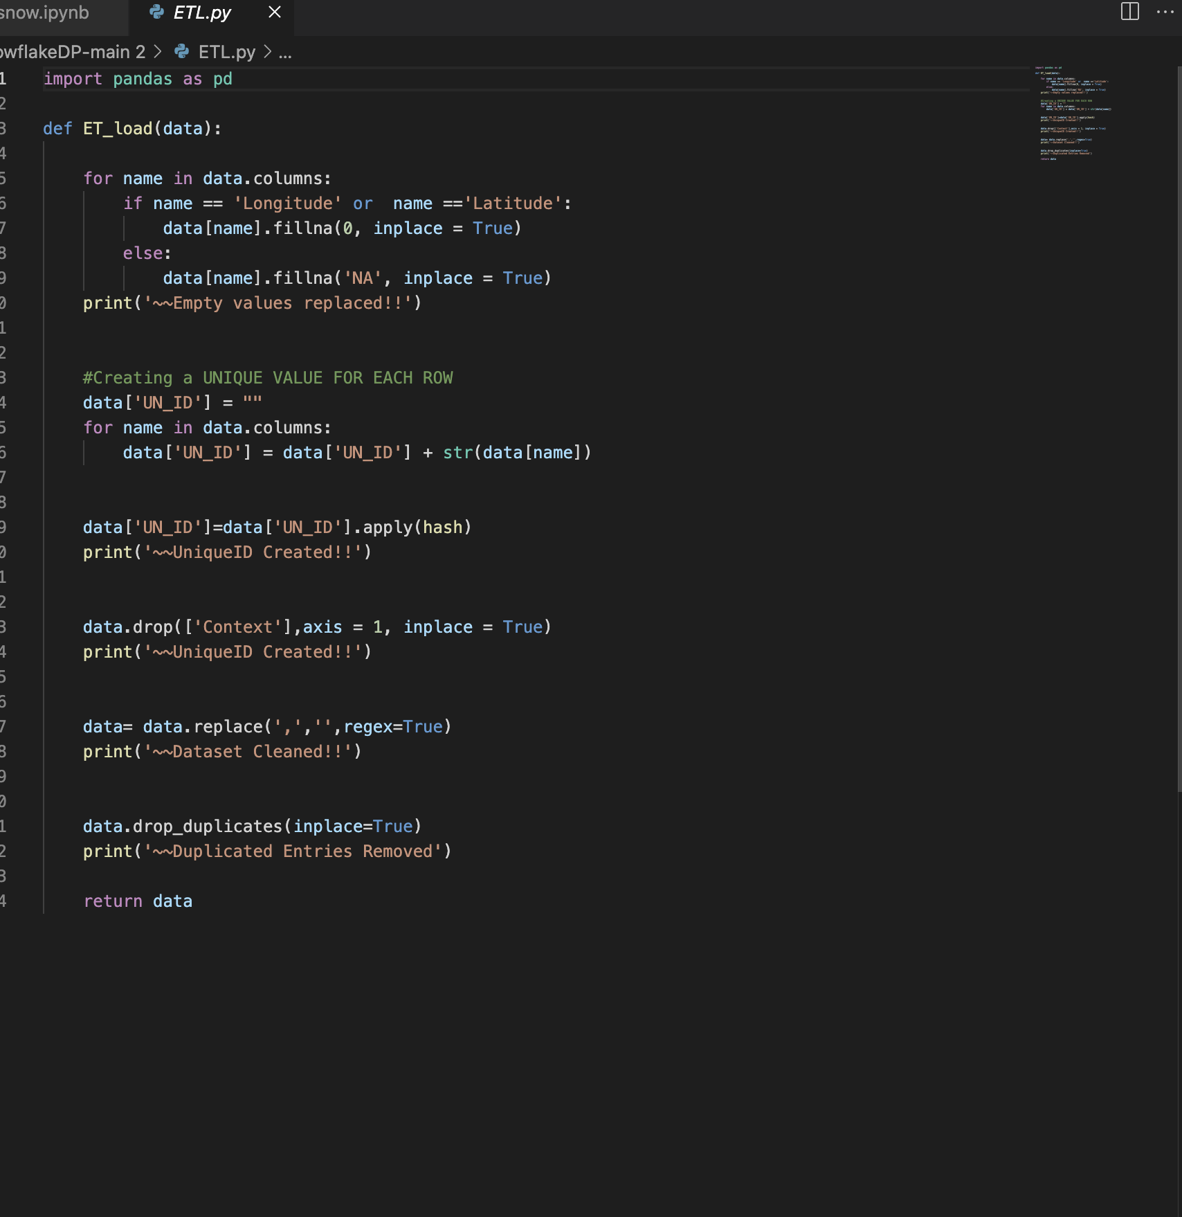
Data Transformation
Created unique id for each row using hash function[‘ID’].
Unnecessary columns are dropped

Slide 8
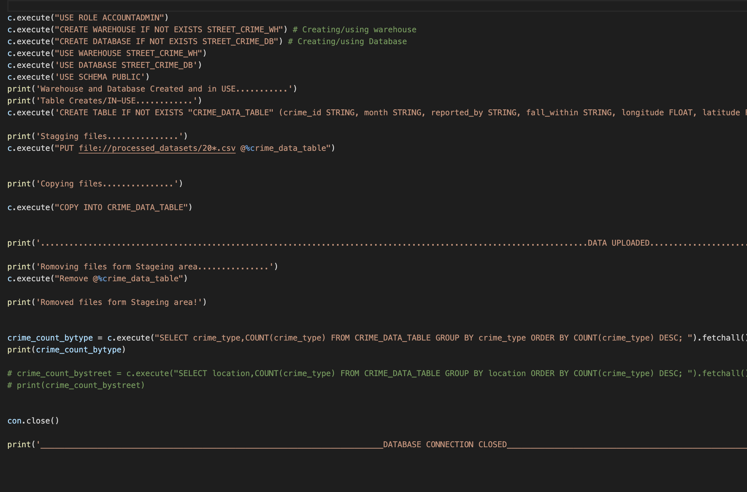
Data Loading
An automated process is created using python and snowflake connector to upload all the data in a snowflake database in a go.

Slide 9
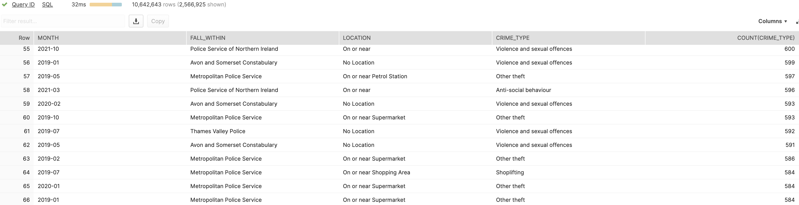
Monthly crime count for each street in UK
SnowSQL Query :-
OUTPUT:-

Slide 10
Thank You

